Slide 1
"search for best area to buy a new residential property in richardson based on multi criteria analysis"
Rohit venkat gandhi Mendadhala
RVG296@utdallas.edu

Slide 2

the challenge?
Most of the real estate websites provide much information about how to purchase your homes basing on the features of houses, pricing.
Very less importance is given to user preference or choices. Like users want to live closer to a School, Work location, Hospitals, Grocery Stores is not satisfied.

Slide 3


What's my solution?
To design a user friendly python application which will allow the potential users to buy houses based on their choices.
This is done integrating the concepts of Webscrapping, API in Python with ArcGIS Pro for the purpose of mapping.
The number of houses that are within the user search are displayed in ArcGIS Pro.

Slide 4
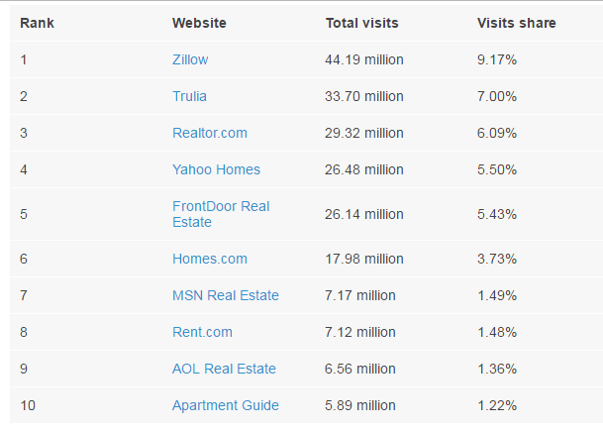
SOME POPULAR REAL ESTATE sources

Slide 5
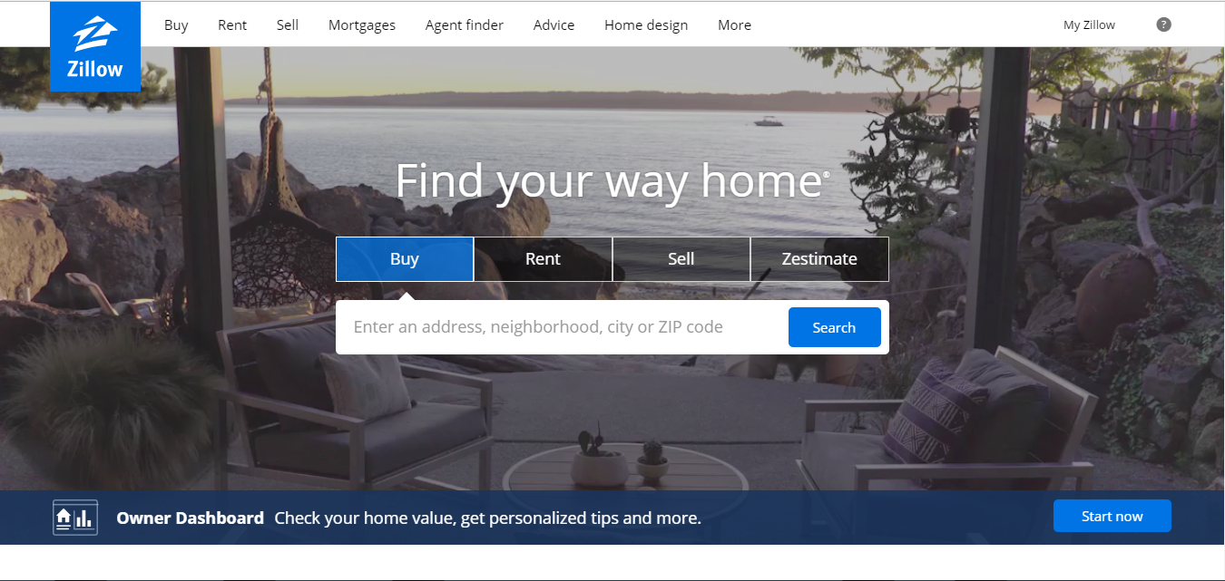
WHAT'S MY PICK AND WHY?

Slide 6
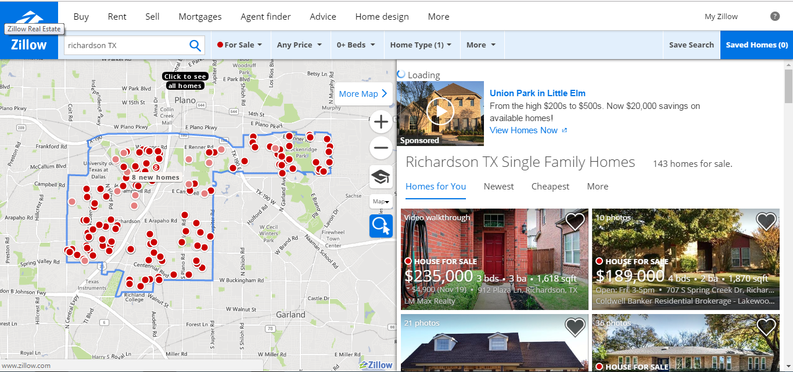
RICHARDSON – MY STUDY AREA

Slide 7
WORKFLOW:
Export Real Estate Information from Zillow as a .csv file
Import it as XY event data and convert to a shapefile
Run the Python Script in Pycharm
Fetch Open source facility shapefiles of Richardson
Project all the shapefiles into one common spatial reference.
Prompt the user to enter his distance parameters
View the resultant houses in ArcGIS Pro

Slide 8
HOW DO I EXPORT DATA FROM ZILLOW?
Best Options:
Through API - Real estate information can be obtained for a particular address.
Web scrapping - Using HTML and Python all the data points can be extracted with their latitude and longitude values.

Slide 9
API Methodology
Package used : Pyzillow
Allows us to convert directly an address and zipcode or zillow id into real estate information from the zillow database
Two main API's used:
GetDeepSearchResults (address and Zipcode)
GetUpdatedPropertyDetails ( zillow id)

Slide 10
Web scrapping using python
Urllib2:
Helps in fetching URL's.
Contains functions and classes to perform actions on URL's
BeautifulSoup:
Helps in extracting data from HTML and XML files.
Saves hours and days of work of developers.
Present as BeautifulSoup in Pycharm Packages. Latest version is bs4
Need to use it in the below format.
from bs4 import BeautifulSoup

Slide 11
POST MAN: (CHROME EXTENSION)
Helps in energizing your API workflows by building, testing and documenting API's much faster.
Main Features are :
To obtain History of sent requests
Create requests frequently
Customization with scripts
Robust Framework

Slide 12
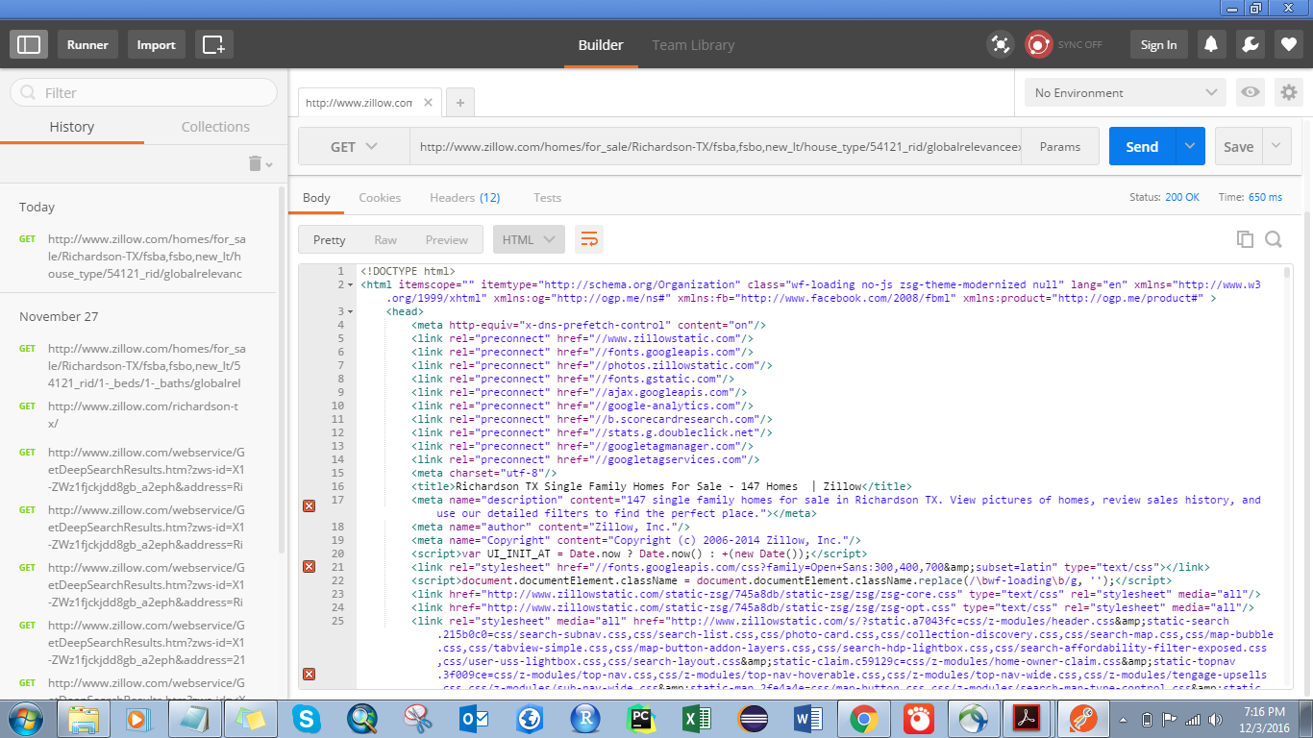
An overview of postman

Slide 13
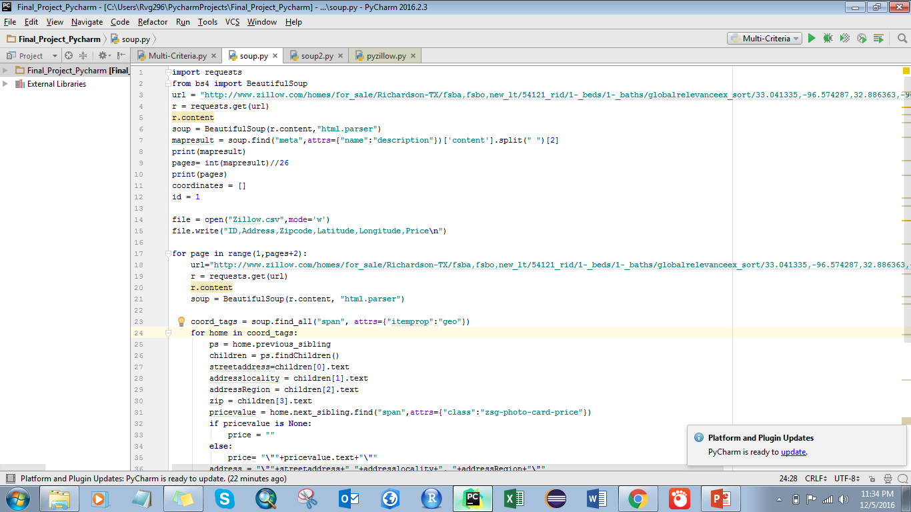
PYTHON WEB SCRAPPING SCRIPT

Slide 14
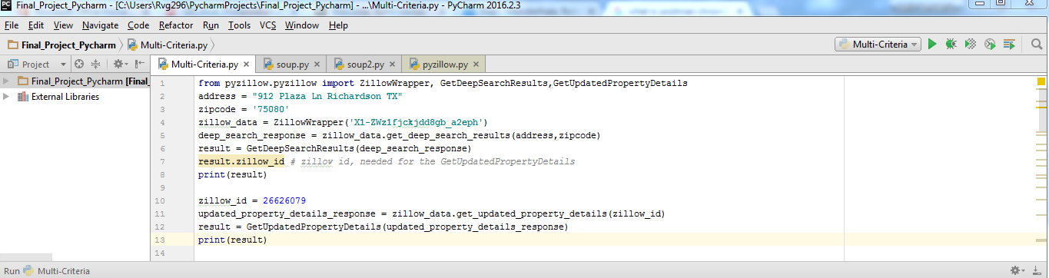
PYthon API SCRIPT FOR ADDRESS TO ZILLOW iD conversion

Slide 15
MULTI FUNCTIONAL CRITERIA USED
Buffer (arcpy.Buffer_Analysis) - Create the buffers
Intersect (arcpy.Intersect_Analysis) - Intersect the buffers
Select (arcpy.Select_Analysis) - Select the houses based on Prices
Select (arcpy.SelectLayerByLocation_management) - Within the resultant area.
Copy (arcpy.Copy_management) -- Used for showing the houses as a separate layer which the user can finalize upon purchasing.

Slide 16
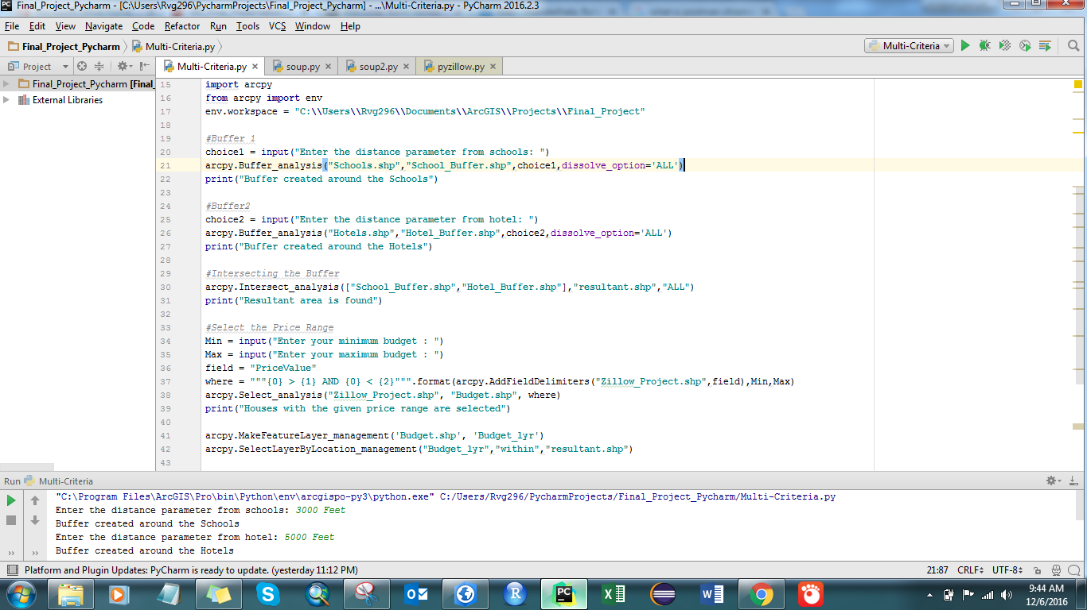
SAMPLE SCRIPT FOR MULTI-CRITERIA

Slide 17
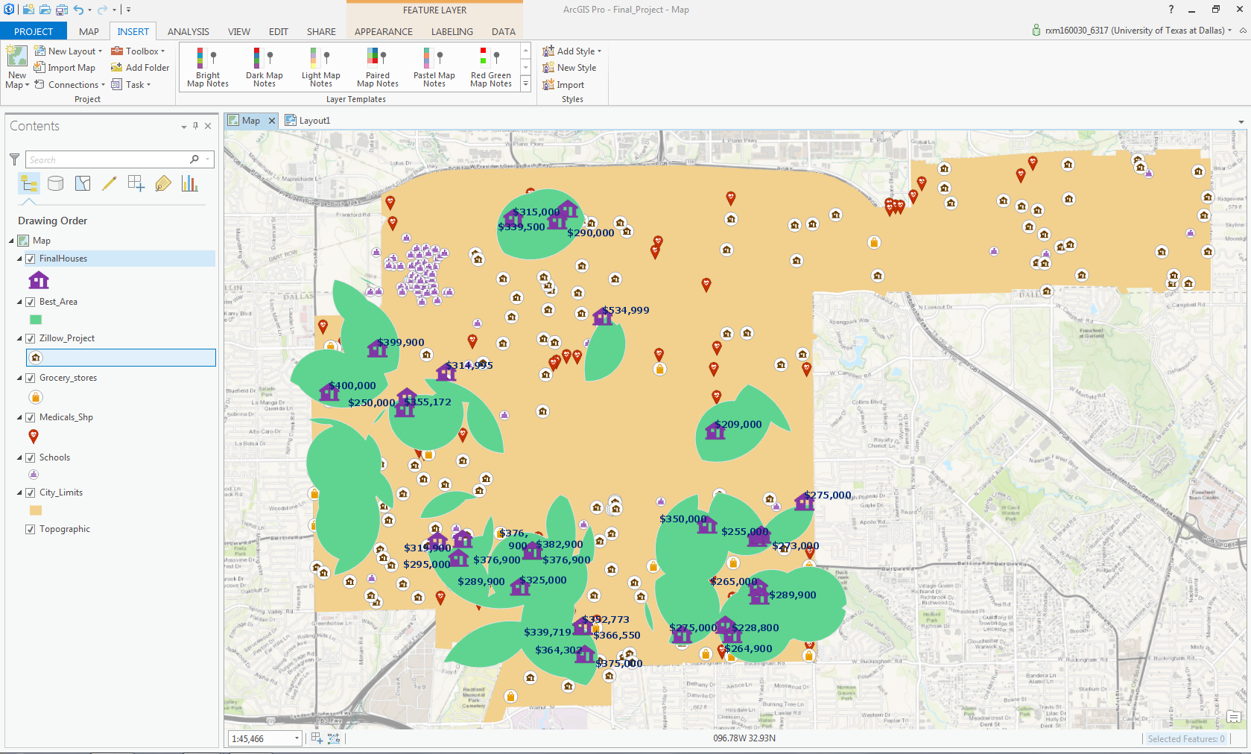
HOUSES THAT SATISFY USER CRITERIA

Slide 18
APPLICATION Usage:
Helps in getting a brief overview of the houses that are present in the neighborhood within the user search criteria.
Most useful for the working staff at UTD if they are interested in purchasing a new house within the vicinity of Richardson, so that they can commute much faster to the university.
Potential users will be getting a clear cut picture about making house and property search

Slide 19
Some LIMITATIONS:
The user should enter a broader search parameters ( >1000 Feet) for the distance and the budget range. (Min – Max Value)
The Python script for web scrapping should be slightly modified as per the number of houses for sale mentioned in the Zillow website. Only the URL and the looping methodology for iterating needs to be modified, the logic for extracting the desired values will be same.
All the data types of the fields should be checked before running the python script and appropriate type casting or conversions need to be done.

Slide 20
References & SOURCES:
http://www.zillow.com/
https://www.getpostman.com/
https://pypi.python.org/pypi/pyzillow/0.5.1
https://www.crummy.com/software/BeautifulSoup/bs4/doc/
http://opendata.richardson.opendata.arcgis.com/
http://www.inman.com/2013/02/13/top-10-real-estate-websites-get-nearly-half-traffic/

Slide 21


